Slide 1
Visualize Your Connections
A Practical Guide to Power BI Graphs
Jake Duddy

Slide 2






Jake Duddy
Data Platform Microsoft MVP
Fabric Community Super User
EvaluationContext Blog
Devon and Cornwall Power BI Group Co-organizer
evaluationcontext.github.io/
linkedin.com/in/jakeduddy/

Slide 3


Scanner API
Scanner API
Workspaces, Items and metadata
workspaces
Graph API
User Groups and Members
users
reports
How do we structure and visualize who has access to each Fabric Items?
users
datasets
users
tables
columns
measures
…
…
https://evaluationcontext.github.io/posts/graphframes/

Slide 4
Graph Theory

Slide 5
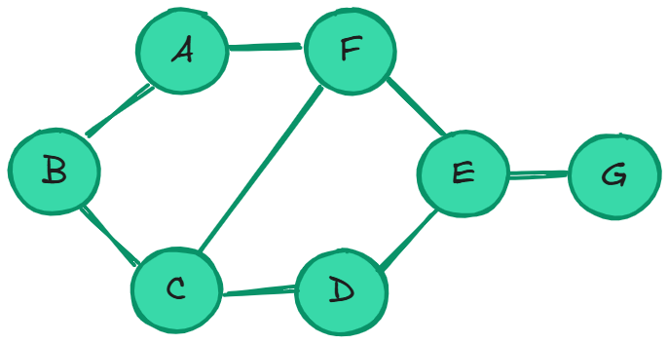
Graph Theory
Representation of relationships between entities
G = (V, E)
V = Vertices
{A, B, C, D, E, F, G}
E = Edges
(u, v) or (src, dst)
{
(A,B),
(B,C),
(C,D),
(D,E),
(E,F),
(F,A),
(C,F),
(E,G)
}

Slide 6
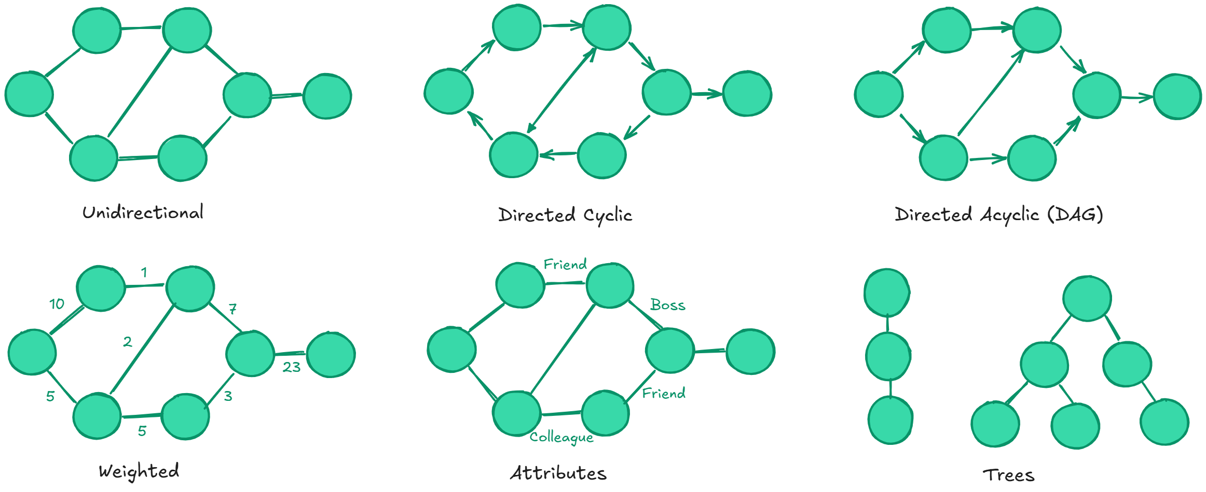
Graph Attributes

Slide 7
Adjacency matrix
Poor compression when considering sparse graphs, better for dense
 | A | B | C | D | E | F | G
A | 0 | 1 | 0 | 0 | 0 | 1 | 0
B | 1 | 0 | 1 | 0 | 0 | 0 | 0
C | 0 | 1 | 0 | 1 | 0 | 1 | 0
D | 0 | 0 | 1 | 0 | 1 | 0 | 0
E | 0 | 0 | 0 | 1 | 0 | 1 | 1
F | 1 | 0 | 1 | 0 | 1 | 0 | 0
G | 0 | 0 | 0 | 0 | 1 | 0 | 0

Slide 8
Adjacency List
Good for sparse graphs, few edges
A | (B, F)
B | (A, C)
C | (B, D, F)
D | (C, E)
E | (D, F, G)
F | (A, E)
G | (E)

Slide 9
Node and Edges
Vertices and Edge attributes would be stored in each respective table
Nodes
A
B
C
D
E
F
G
Edges
src | dst
A | B
B | A
B | C
C | B
… | …
G | E

Slide 10
Triplets
Tabular, well suited for Power BI
Vertices and Edge attributes would all be stored in the same table
src | dst
A | B
B | A
B | C
C | B
A | F
… | …
G | E

Slide 11
User Permissions

Slide 12
Constructing the graph
Graph Properties
Directed
Non-weighted
Attributes
Role Type [Admin, Member..]
Possibly Cyclic (groups)
Disseminating Permissions
Graphframes & Pregel
Once have graph can use graph algorithms for clustering etc.
Recursive CTEs
workspaces
users
reports
users
datasets
users
tables
columns
measures
…
…
https://evaluationcontext.github.io/posts/graphframes/

Slide 13
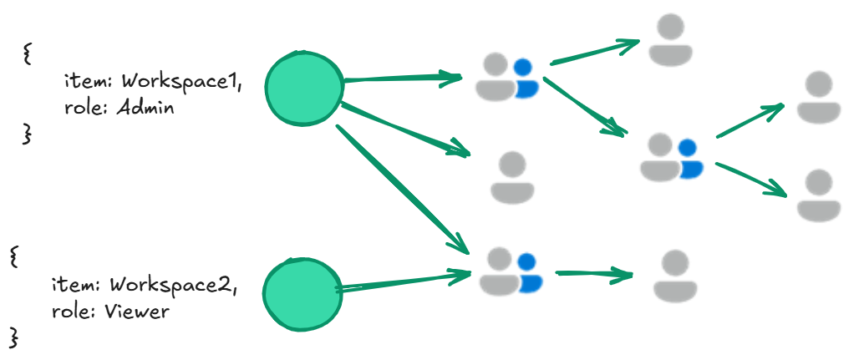

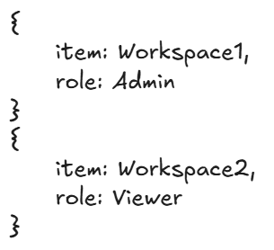
Pregel
Multiple iterations of Supersets
Per Superset
Map: Every vertex sends a Message to adjacent vertices via edges
Reduce: Each vertex combines the received messages
https://evaluationcontext.github.io/posts/graphframes/

Slide 14
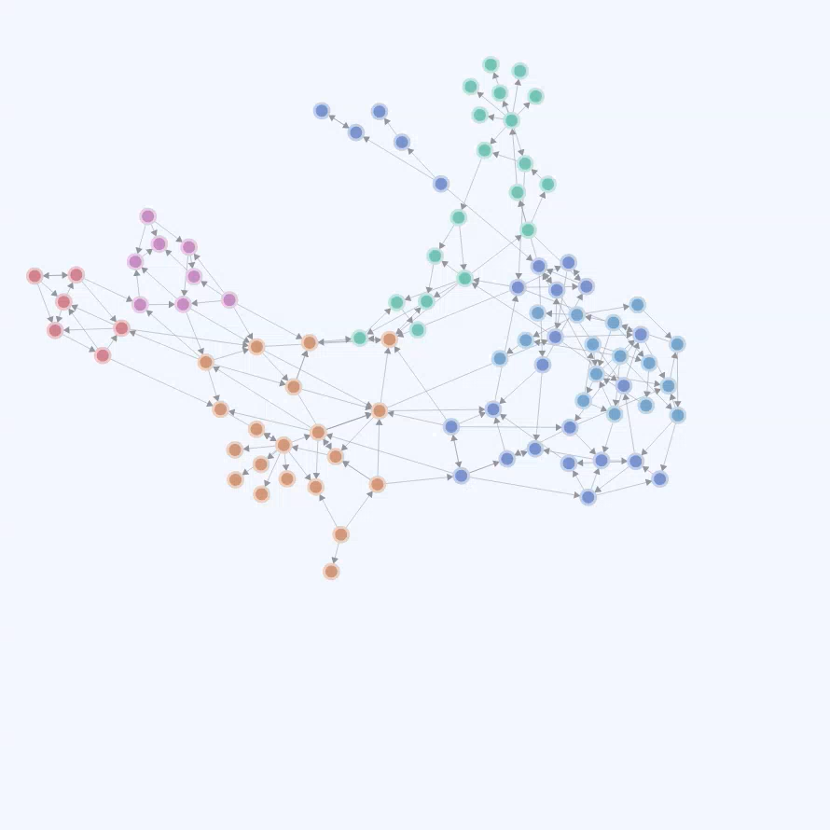
Visualizing the graph
Custom Visuals
Many force direct graph visuals
Limitations and limited customization
Deneb
Davide Bacci Github
Union of nodes and edges
Makes filtering the graph hard
Triplet form is preferred
Limitations
Need to “pre-calculate” grouping to filter to sub-graph
Can’t trim irrelevant nodes
https://evaluationcontext.github.io/posts/deneb-force-directed/

Slide 15
Demo

Slide 16
Trimming the Graph
To trim a sub-graph to only relevant graph to edges and nodes, you would need to loop through the graph to remove irrelevant nodes
Python and R
Limitations
Row Limit: 150,000 rows
Non-interactive
Why not use a different engine, built for graph processing?
Fabric
KQL Database
Cosmos (in preview)
Direct Query and Dynamic M Parameters
https://evaluationcontext.github.io/posts/KQLGraph/

Slide 17
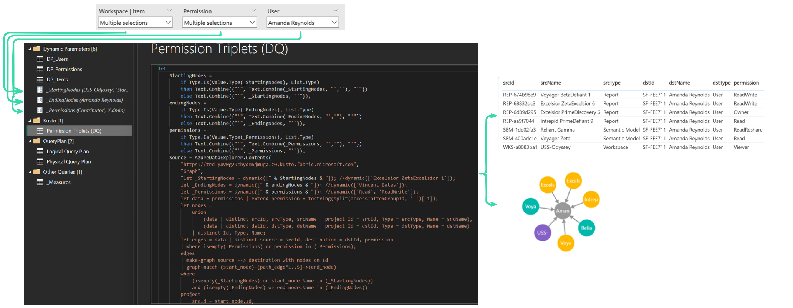
Dynamic M Parameters
https://evaluationcontext.github.io/posts/KQLGraph/

Slide 18
Demo

Slide 19
DAX Query Plan

Slide 20
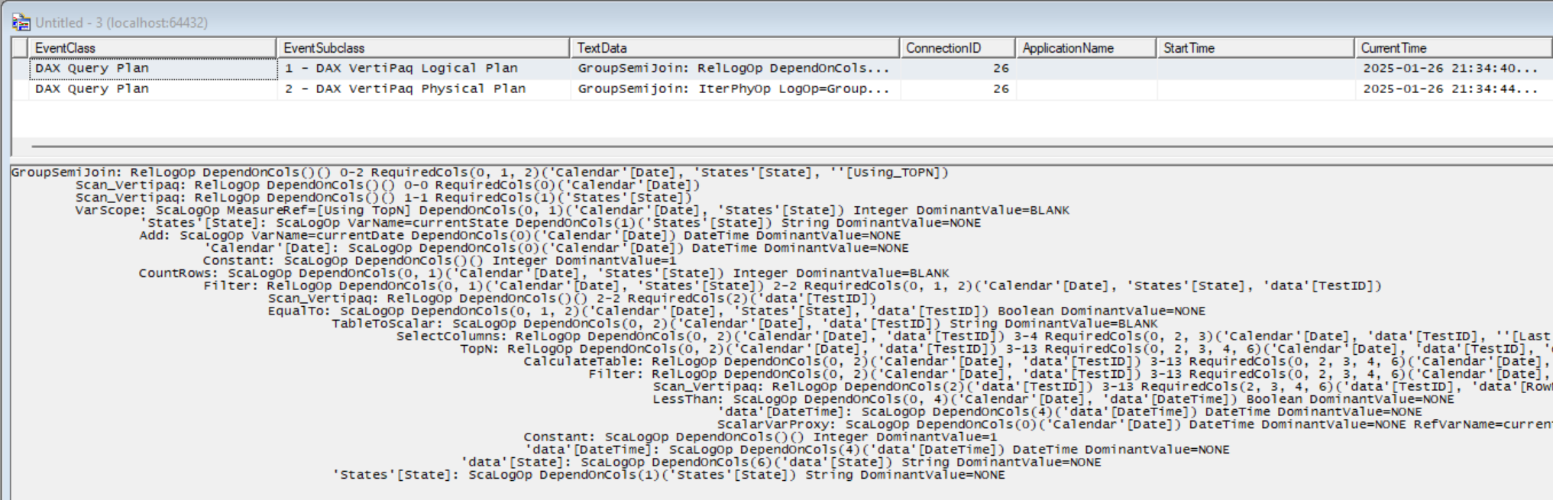
DAX Query Plan
Each increase in indent represents a nested operation

Slide 21
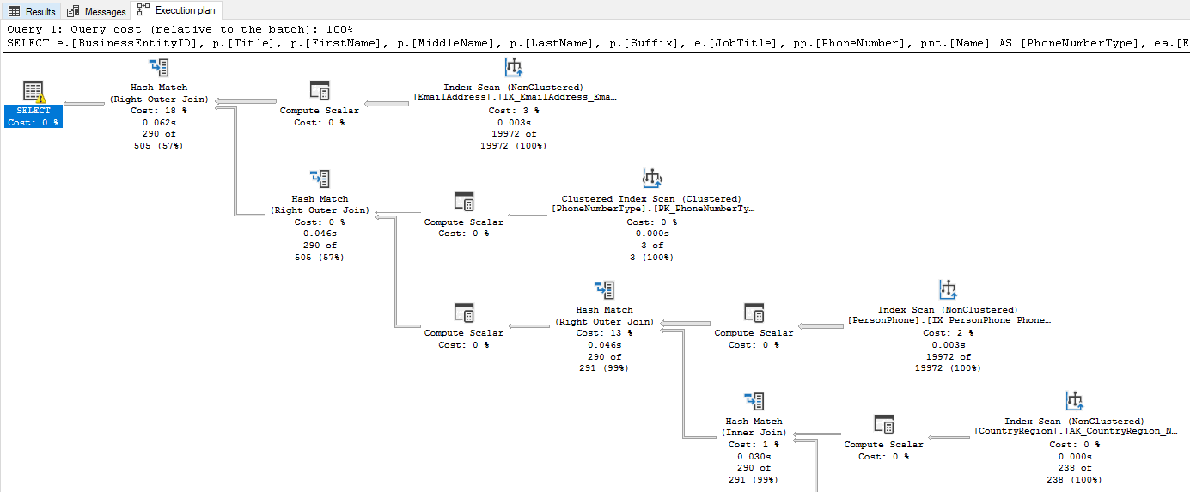
SQL Server Query Plan
https://learn.microsoft.com/en-us/sql/relational-databases/performance/display-an-actual-execution-plan?view=sql-server-ver16

Slide 22
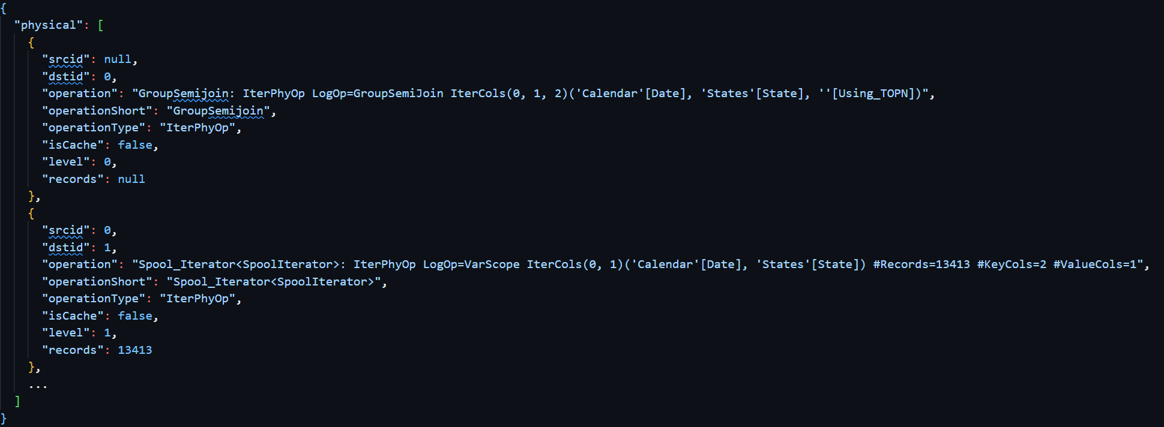
DAX Query Plan To Graph
Parse XML to dict
Split indents to generate Physical and Logical Plans Graphs
https://evaluationcontext.github.io/posts/query-plan-graph/

Slide 23
Demo

